Slide 1
International Service Facility – Fostering international cooperation among NCPs in Europe and Partner Countries
Networking opportunities and practical advice for your daily work as NCP
Webspace and links to relevant NCP information material and e-learning modules: https://horizon-ncp.eu/user
Webinars introducing you to International Cooperation in Horizon 2020 and Horizon Europe
Total: 8 Webinars
All upcoming webinars will be announced and – following the event - uploaded here: https://horizon-ncp.eu/user
and here: https://www.eucelac-platform.eu/lac-ncp-network
Notes:
The International Service Facility has been contracted by the European Commission to provide support to all National Contact Points (NCPs) in EU Partner Countries. We are pleased to inform you that new networking opportunities and practical advice for your daily work as a National Contact Point (NCP) are now available :

Slide 2
International Service Facility – Fostering international cooperation among NCPs in Europe and Partner Countries
Newsflashes that will provide you with networking opportunities and practical advice for your daily work as a National Contact Point (NCP) within the Horizon 2020 and the future Horizon Europe Programmes in the upcoming 16 months.
Total: 10 Newsflashes
Published so far: 3 Newsflashes
1st Newsletter: https://mailchi.mp/72dfd002357a/ncp-test-20190515_v2
2nd Newsletter: https://mailchi.mp/027df4ab99ec/2nd-newsletter-for-ncps-in-eu-partner-countries?e=[UNIQID]
3rd Newsletter: https://mailchi.mp/0583a99fc748/3rd-newsletter-for-ncps-in-eu-partner-countries?e=[UNIQID]

Slide 3
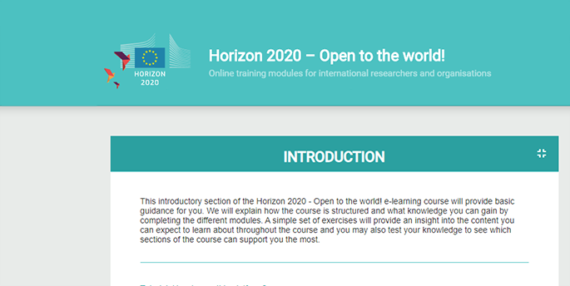
Horizon 2020 E-Learning: Register Now!
From basic knowledge to advanced training modules, this platform will give you access to a comprehensive E-learning experience to help you to gather knowledge on how to participate in Horizon 2020. All modules are free of charge!
Register here:
http://inco.emg.group

Slide 4
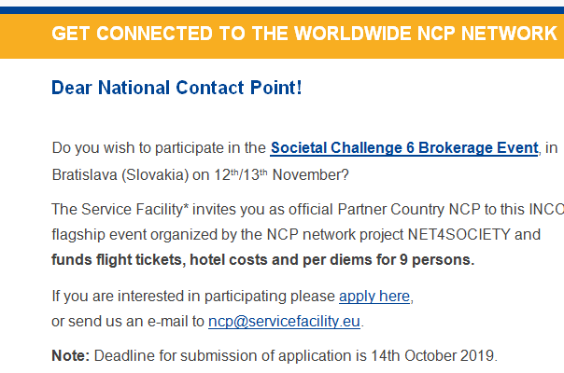
Opportunities for you to connect with flagship events and European NCP projects to share experiences
Live streams and broadcasting of flagship events
Coverage of Travel Costs for selected NCP’s
Contact us for more infos: ncp@servicefacility.eu

